Slide 1
AME 40453 Automation and Controls Lab
www.nd.edu/~prumbach/AME40453
Paul Rumbach
prumbach@nd.edu
363 Fitzpatrick Hall
Labs begin this week in B14 Fitzpatrick!

Slide 2
Office Hours: Monday and Wednesday 2 – 3pm

Slide 3

Engineering Differential Equations by Bill Goodwine

Slide 4
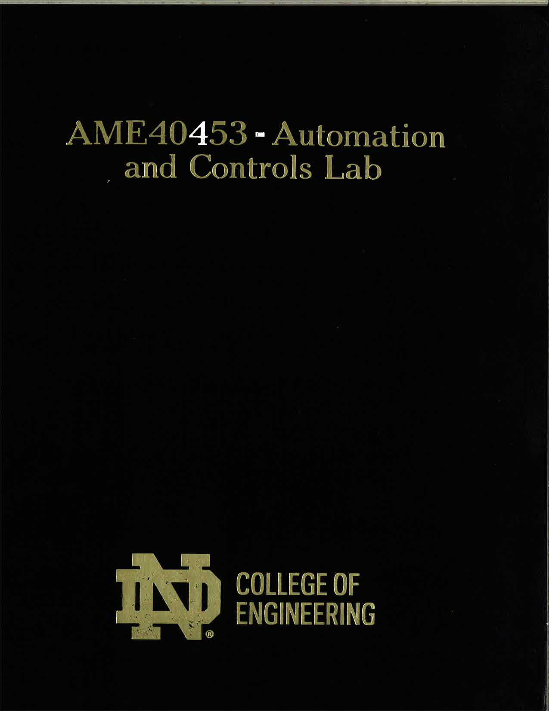
Official Lab Notebook
(Required)
Free in Lab!

Slide 6
COVID-19 Protocols
Wash hands upon entering the lab.
Put on nitrile gloves after washing hands.
Sanitize lab bench and equipment with alcohol wipes after performing the lab.
Wear a mask at all times during lab.

Slide 7
Grading Scale
35% Technical Memos (7 total)
30% Pre-lab Assignments (7 total)
10% Lab Notebooks (11 total)
10% Final Project Presentation and Performance
10% Final Project Written Lab Report
5% C5 Motor Mount Build

Slide 8
Pre-Lab Assignments – due Friday mornings

Slide 9
Tech Memos – due Wednesdays

Slide 11
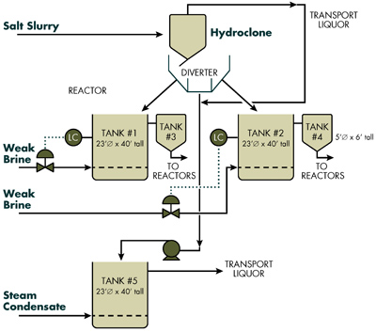
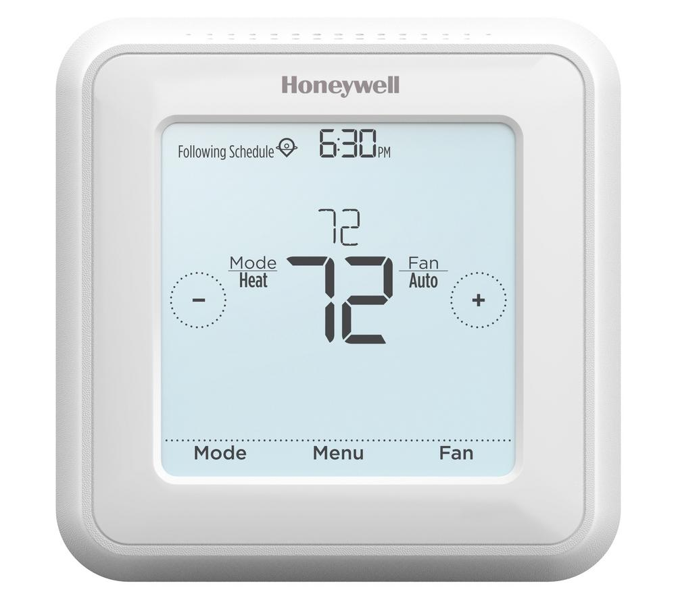
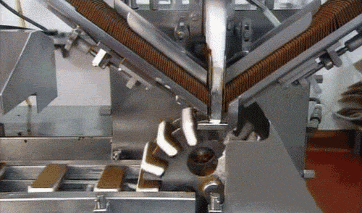
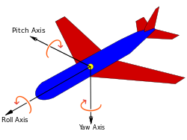
Automation and Controls

Slide 12
General Approach
Develop Model – Write down governing eqs.
Design Controller – Open loop, PID, LQR, etc.
Predict Performance – Solve eqs. for transient behavior
System Identification – Measure parameters that go into the model (i.e. time constants, resonance frequency, damping ratio)
Implement Controller – Connect and calibrate sensors and actuators. Write code.
Validate and Compare Performance – Test controller. Compare measured output to predictions.
PRE-LAB
LAB EXERCISE
TECH MEMO

Slide 13
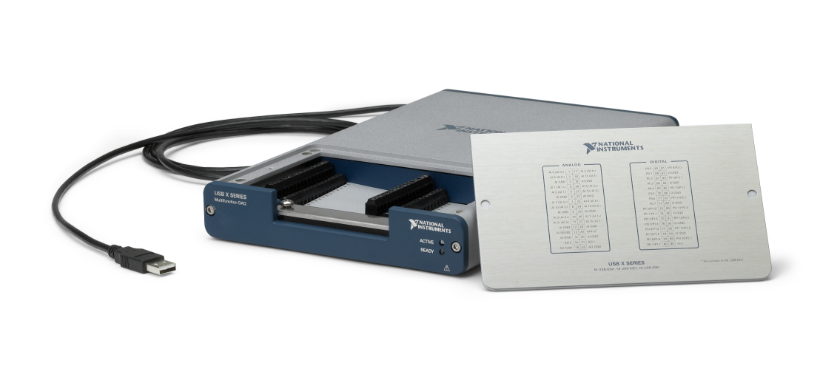
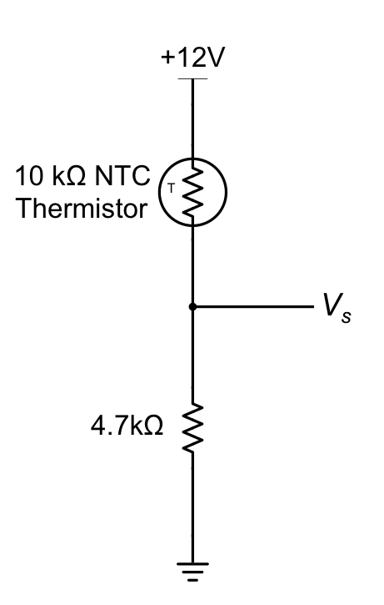
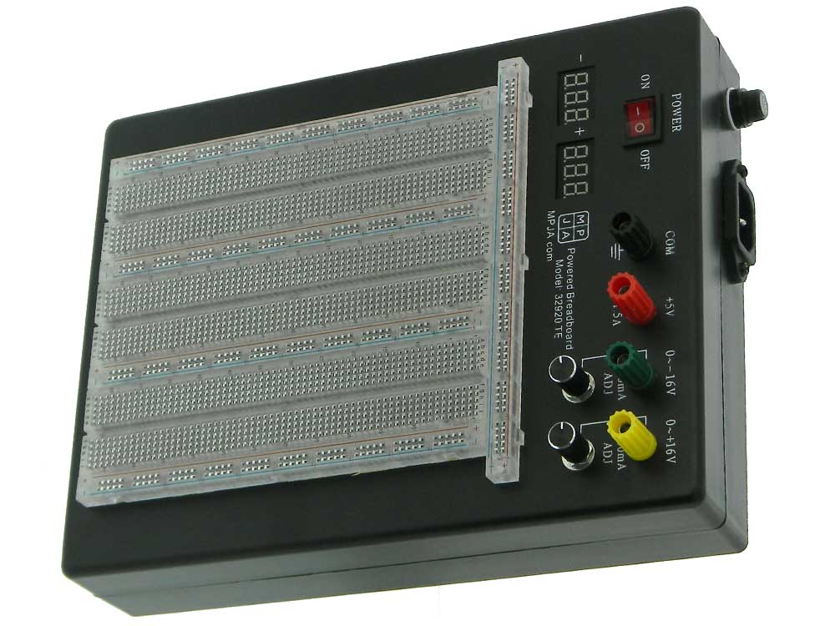
C1 - Introduction
Thermistor in a Voltage divider
Voltage Divider Equation
Steinhart Equation

Slide 14

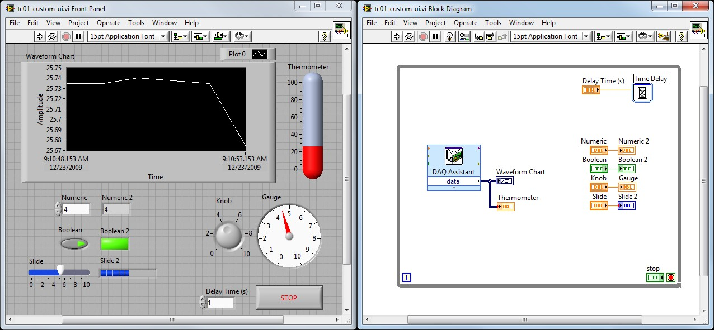

Slide 15
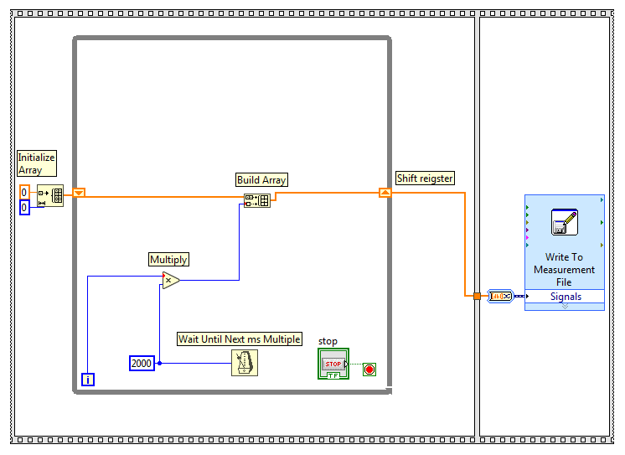
LabView

Slide 16
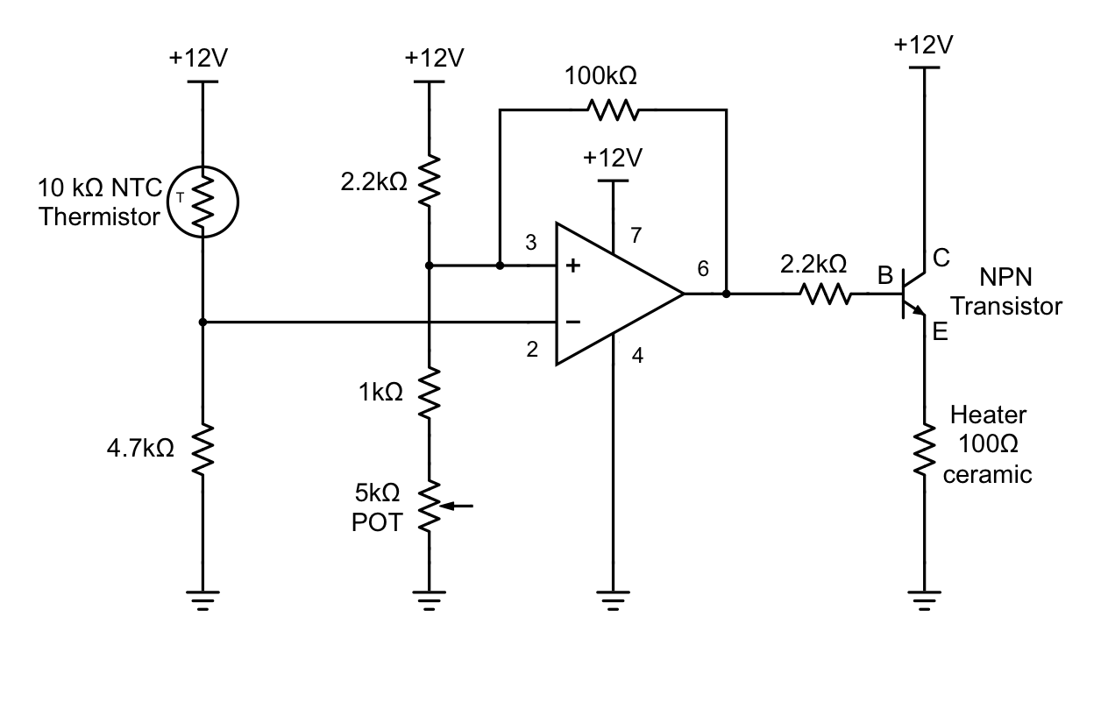
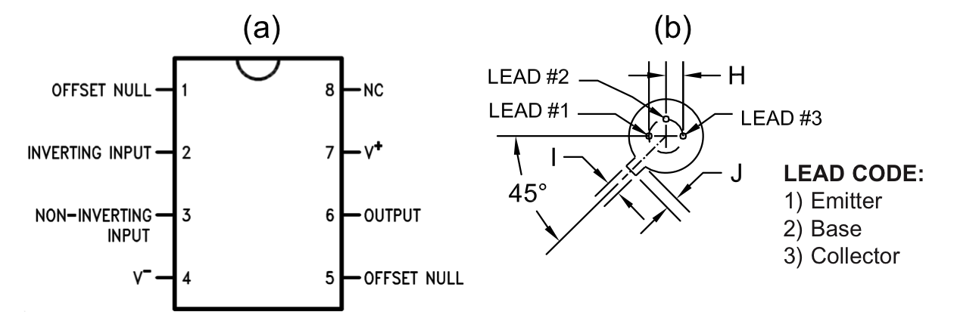
C2 – Analog Thermostat

Slide 17
FINAL PROJECT

